Slide 2
Shelly Simmons – Executive Director

Slide 3
STATEWIDE REPORT
Center Expansion
BAIN, Inc – Valdosta Office
Continuing Momentum
$149K recommended by the House
Need Senate recommendation

Slide 4
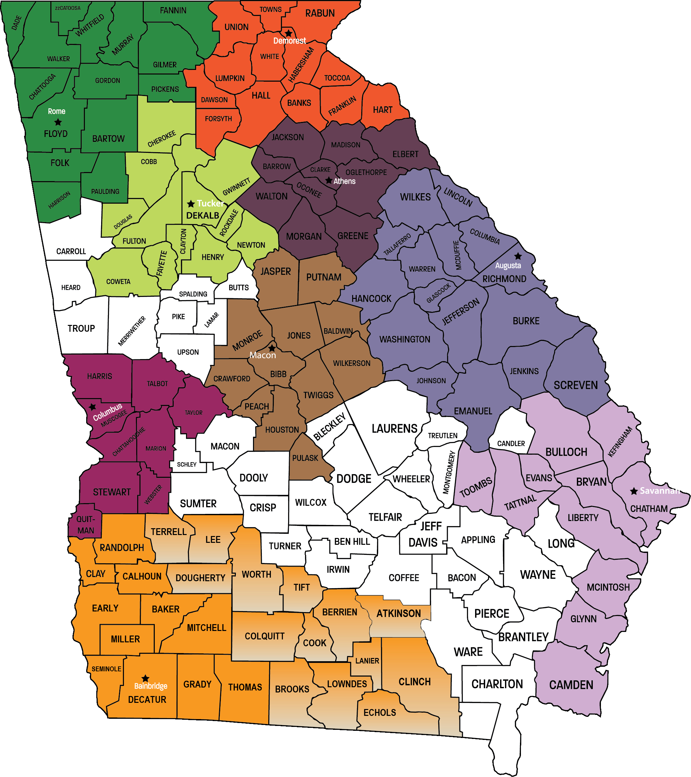
CURRENT CENTER
COVERAGE

Slide 5
STATEWIDE REPORT cont’d
Contact local Senator – www.openstates.org
Contact the Senate Appropriations Human Development & Public Health Subcommittee
Sen. Renee Unterman (Chairman)
Sen. Dean Burke (Vice Chairman)
Sen. Chuck Hufstetler, Sen. Greg Kirk, Sen. Butch Miller, Sen. Horacena Tate, Sen. Ben Watson, Sen. Jack Hill (Members)
Future Plans
Enable Work

Slide 6
Jordan Hall – Mobility Coordinator

Slide 7
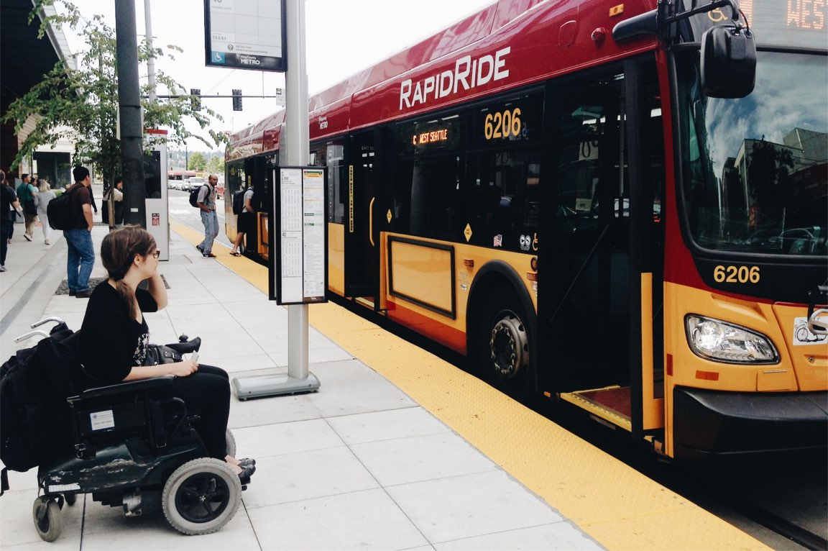
MOBILITY SURVERY RESULTS

Slide 8
99 PARTICIPANTS
37 COUNTIES

Slide 9
TRANSPORTATION
USAGE

Slide 10
MOBILITY
BARRIERS

Slide 11
POSSIBLE IMPROVEMENTS
Microtransit
TransLoc
September 2018 – Pilot in Gwinnett County
Encourage participation locally

Slide 12
For questions or further info send an email to:
JHALL@SILCGA.ORG

Slide 13
Becky Ramage-Tuttle - Assistant Director
Marty Collier - Housing Coordinator

Slide 15
HOME ACCESS PROGRAM
$200,000 for the present fiscal year
11 modifications completed and 11 under construction
Projects have included – grab bars, bathroom modifications, widening of doorways, ramps, etc.
Projects require STRONG consumer participation

Slide 16
AFFORDABLE HOUSING LEGISLATION
HB 346 - Healthy Housing
Prohibits retaliatory eviction of tenants complaining to code enforcement of unsafe and unhealthy rental housing conditions.
Status: Passed the House; Senate Judiciary Committee.

Slide 17
AFFORDABLE HOUSING LEGISLATION – cont’d
HB 388 - Development Impact Fees
Allows local communities to waive the development impact fee for affordable housing without replenishing the funds from another source.
Status: House Rules Committee. Seeking a vehicle.

Slide 18
AFFORDABLE HOUSING LEGISLATION – cont’d
HR 164 - Dedication of Revenue by General Law
Constitutional amendment to authorize the General Assembly to dedicate revenue by general law for up to 1% of the total state budget, upon a 2/3 vote of the House and Senate, without a statewide referendum.
Status: Passed House; Senate Appropriations Committee

Slide 19
AFFORDABLE HOUSING LEGISLATION – cont’d
HB 313 - Tax Exemption for Habitat for Humanity
Property tax exemption for real property owned by purely public charities where property is held exclusively for the purpose of building or repairing single family homes to be financed to individuals using no-interest loans. Requires statewide referendum. See also, SB 197.
Status: House Ways & Means. HB 313 did not move but its provisions were amended onto HB 344 and passed the House by Committee Substitute; Senate Finance Committee.

Slide 20
AFFORDABLE HOUSING LEGISLATION – cont’d
HB 31 FY 2020 Budget - DBHDD, Adult Mental Health Services
Increase funds for state housing vouchers for 700 persons for permanent supportive housing for persons with severe and persistent mental illness cycling through courts, jails, prisons, hospitals and emergency departments - $2.5M
Fund state match funds for HUD HomeFirst public-private partnership to provide behavioral health services in permeant homeless supported housing - $500K
Status: Passed House; Senate Appropriations Committee. FY 20 Budget anticipated to be on the Senate floor for a
vote early in the week of March 18.

Slide 21
For individual housing needs, please contact your local Center for Independent Living and/or visit
AFFORDABLEHOUSINGONLINE.ORG

Slide 22
Parker Glick – Outreach Coordinator

Slide 23
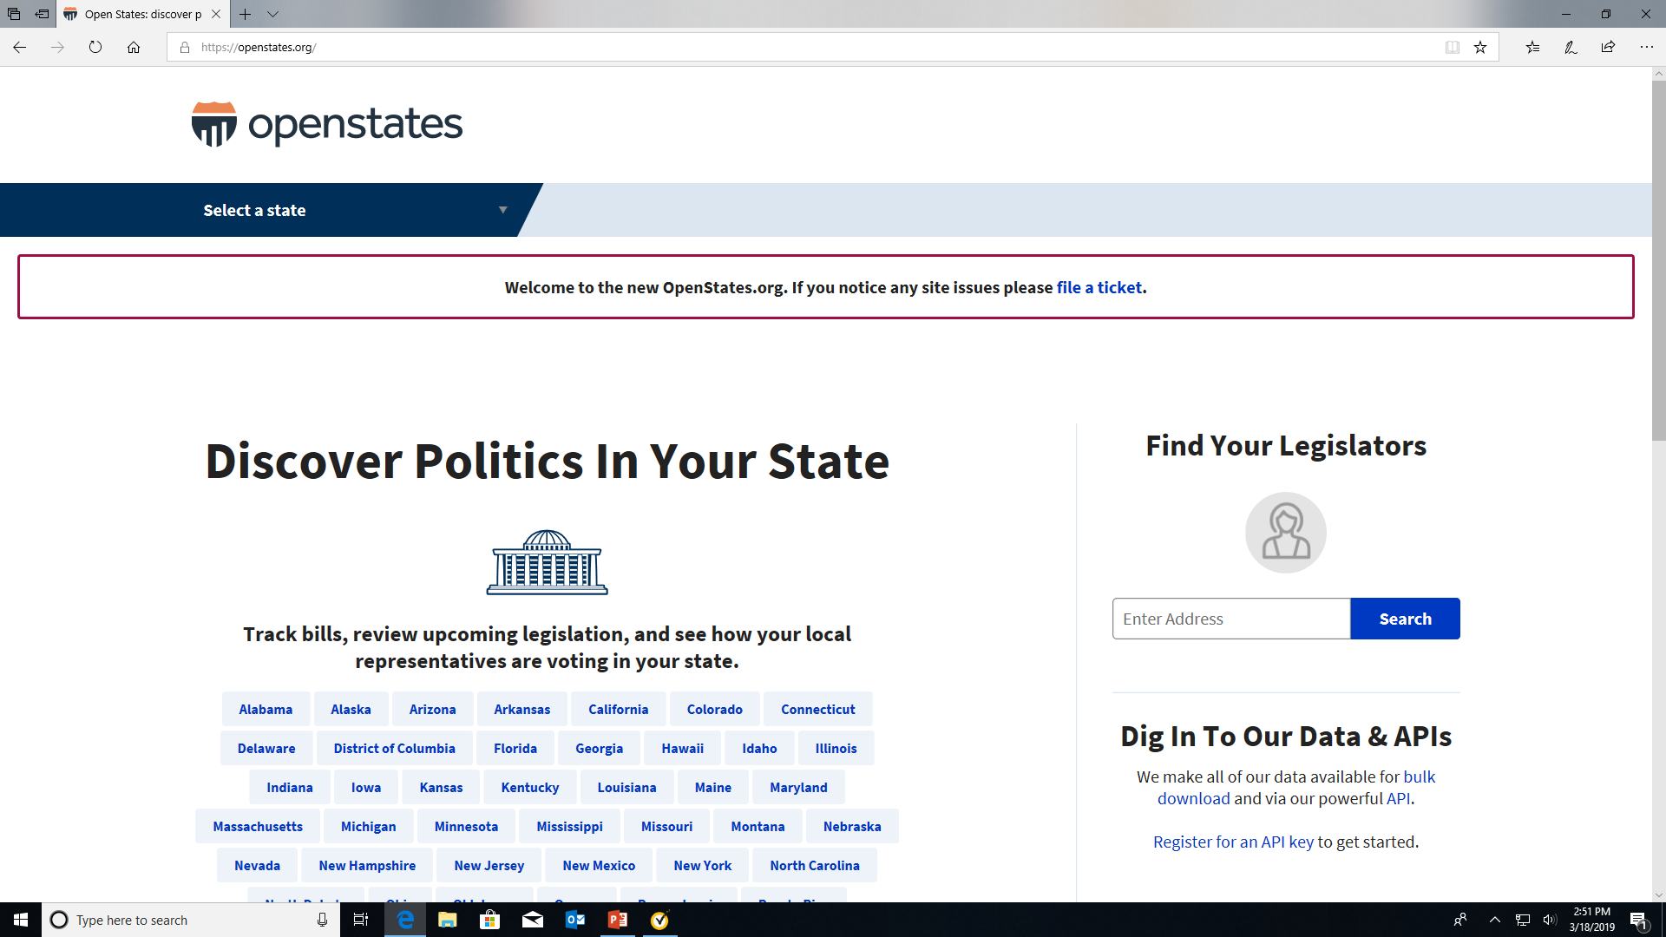

Slide 24
GET INVOLVED
Establish relationships with legislators
Share our one pagers
www.silcga.org/2019-legislative-agenda
Join us for our annual Strengthening Independent Living event on September 25th, 2019
Join our Board of Directors
Donate at www.silcga.org/donate

