Slide 1
Shelly Simmons – Welcome & Introduction

Slide 2
Agenda
Welcome
Congressman Hank Johnson
SILC Activities & Collaborations
SILC Legislative Agenda
Senator Jon Ossoff’s office – Teresa Dukes
Gaylon Tootle – Walton Options for IL
Charlie Miller – GCDD

Slide 3
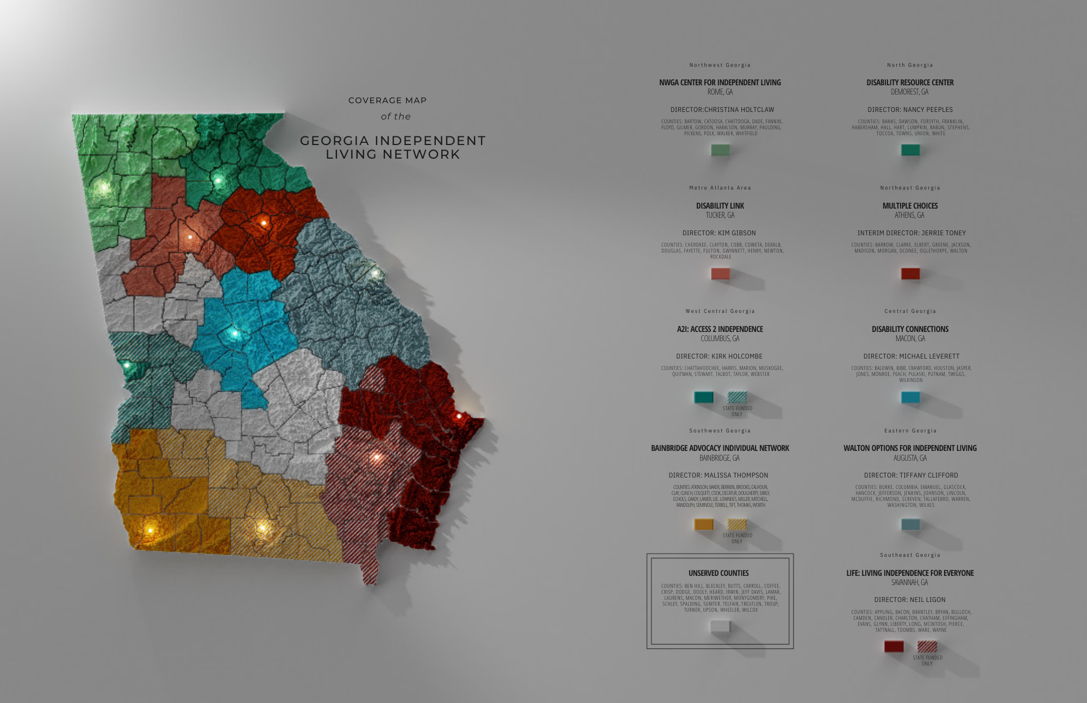

Slide 5
Funding Restoration
Contact local Representative – www.openstates.org
Contact the Appropriations Human Resources Subcommittee
Rep. Katie Dempsey (Chairperson)
Rep. Tom Kirby (Vice Chairman)
Rep. Tommy Benton, Rep. Emory Dunahoo, Rep. Don Hogan, Rep. Wayne Howard, Rep. Karen Mathiak, Rep. Greg Morris, Rep. Mary Margaret Oliver and Rep. Bert Reeves (Members)

Slide 6
Funding Restoration
Contact local Senator – www.openstates.org
Contact the Senate Appropriations Human Development & Public Health Subcommittee
Sen. Ben Watson (Chairman)
Sen. Dean Burke (Vice Chairman)
Sen. Emanuel Jones, Sen. Butch Miller, Sen. Kay Kirkpatrick, Sen. Nan Orrock, and Sen. Lindsey Tippins (Members)

Slide 7
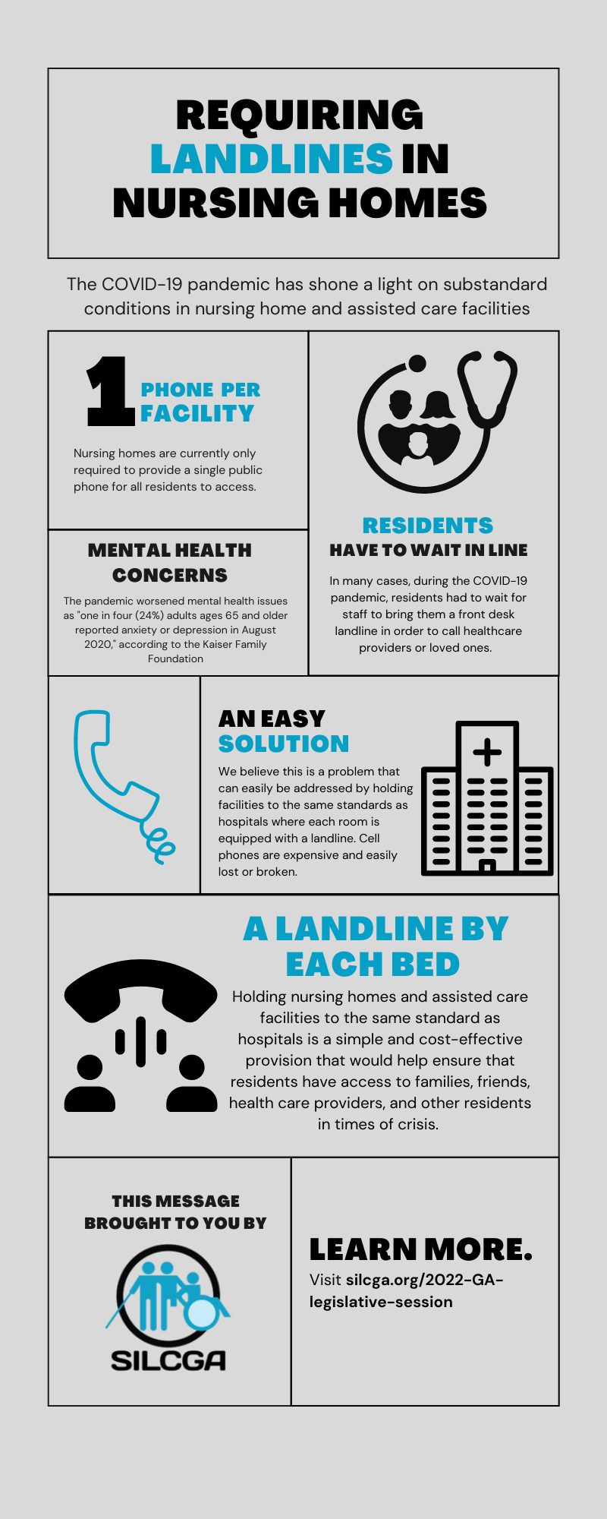

Slide 8
Senator Jon Ossoff’s office – Teresa Dukes

Slide 9
Gaylon Tootle – Voting Rights – Walton Options for Independent Living

Slide 10
Charlie Miller – Legislative Agenda – GCDD

Slide 11
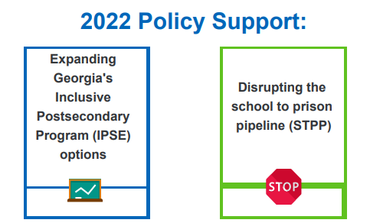

Slide 12
Questions?
Contact GCDD's Legislative Advocacy Director: Charlie Miller, at charles.miller@gcdd.ga.gov
OR
GCDD's Public Policy Research and Development Director: Dr. Alyssa Miller, at alyssa.lee@gcdd.ga.gov
For more information on GCDD, visit our website: gcdd.org

Slide 13
